Slide 1
CUSTOMER RETENTION

Slide 2
PROBLEM STATEMENT
Customer satisfaction has emerged as one of the most important factors that guarantee the success of online store; it has been posited as a key stimulant of purchase, repurchase intentions and customer loyalty. A comprehensive review of the literature, theories and models have been carried out to propose the models for customer activation and customer retention. Five major factors that contributed to the success of an e-commerce store have been identified as: service quality, system quality, information quality, trust and net benefit. The research furthermore investigated the factors that influence the online customers repeat purchase intention. The combination of both utilitarian value and hedonistic values are needed to affect the repeat purchase intention (loyalty) positively. The data is collected from the Indian online shoppers. Results indicate the e-retail success factors, which are very much critical for customer satisfaction.

Slide 3
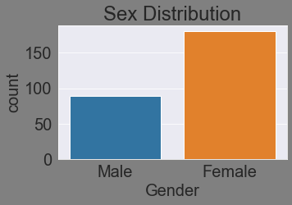
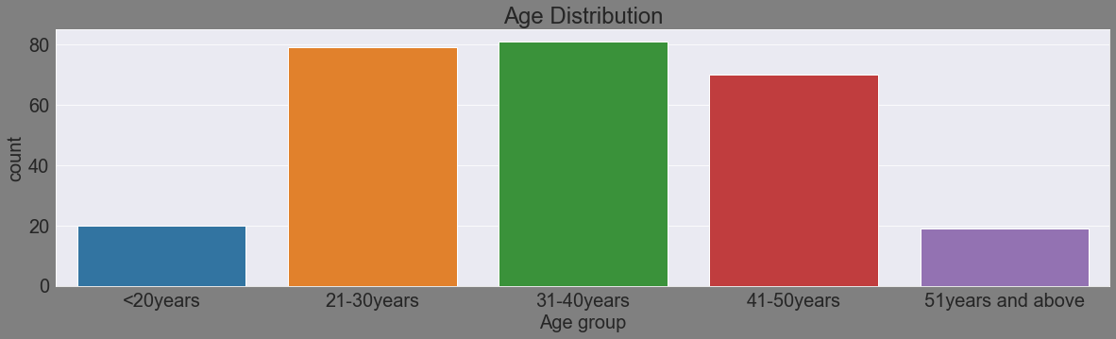

Slide 4
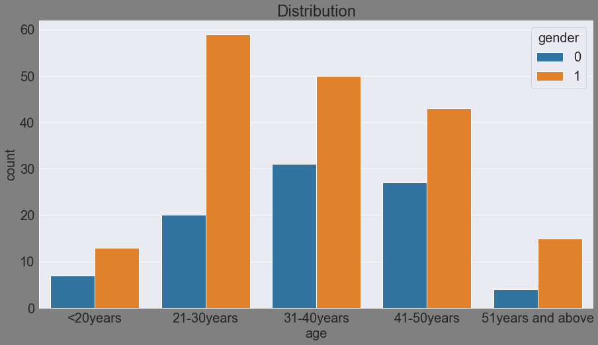
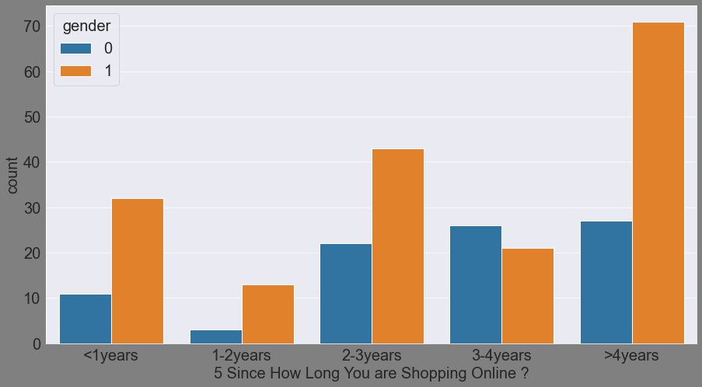

Slide 5
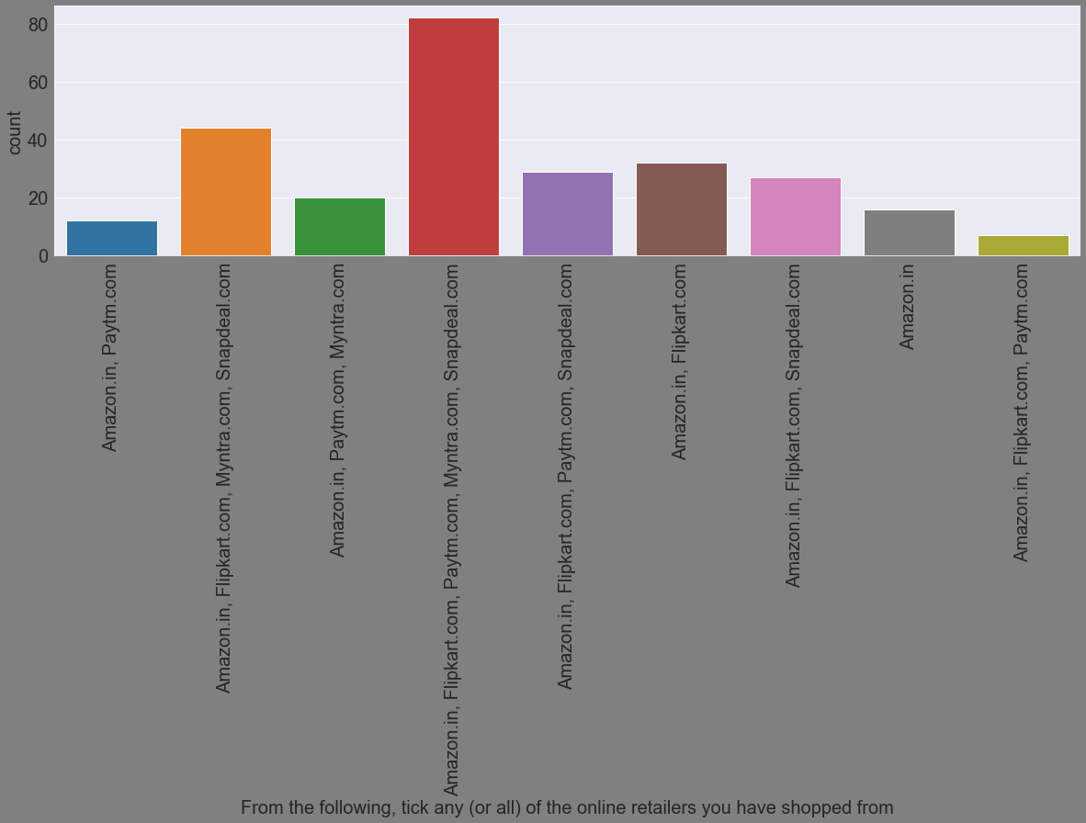

Slide 6
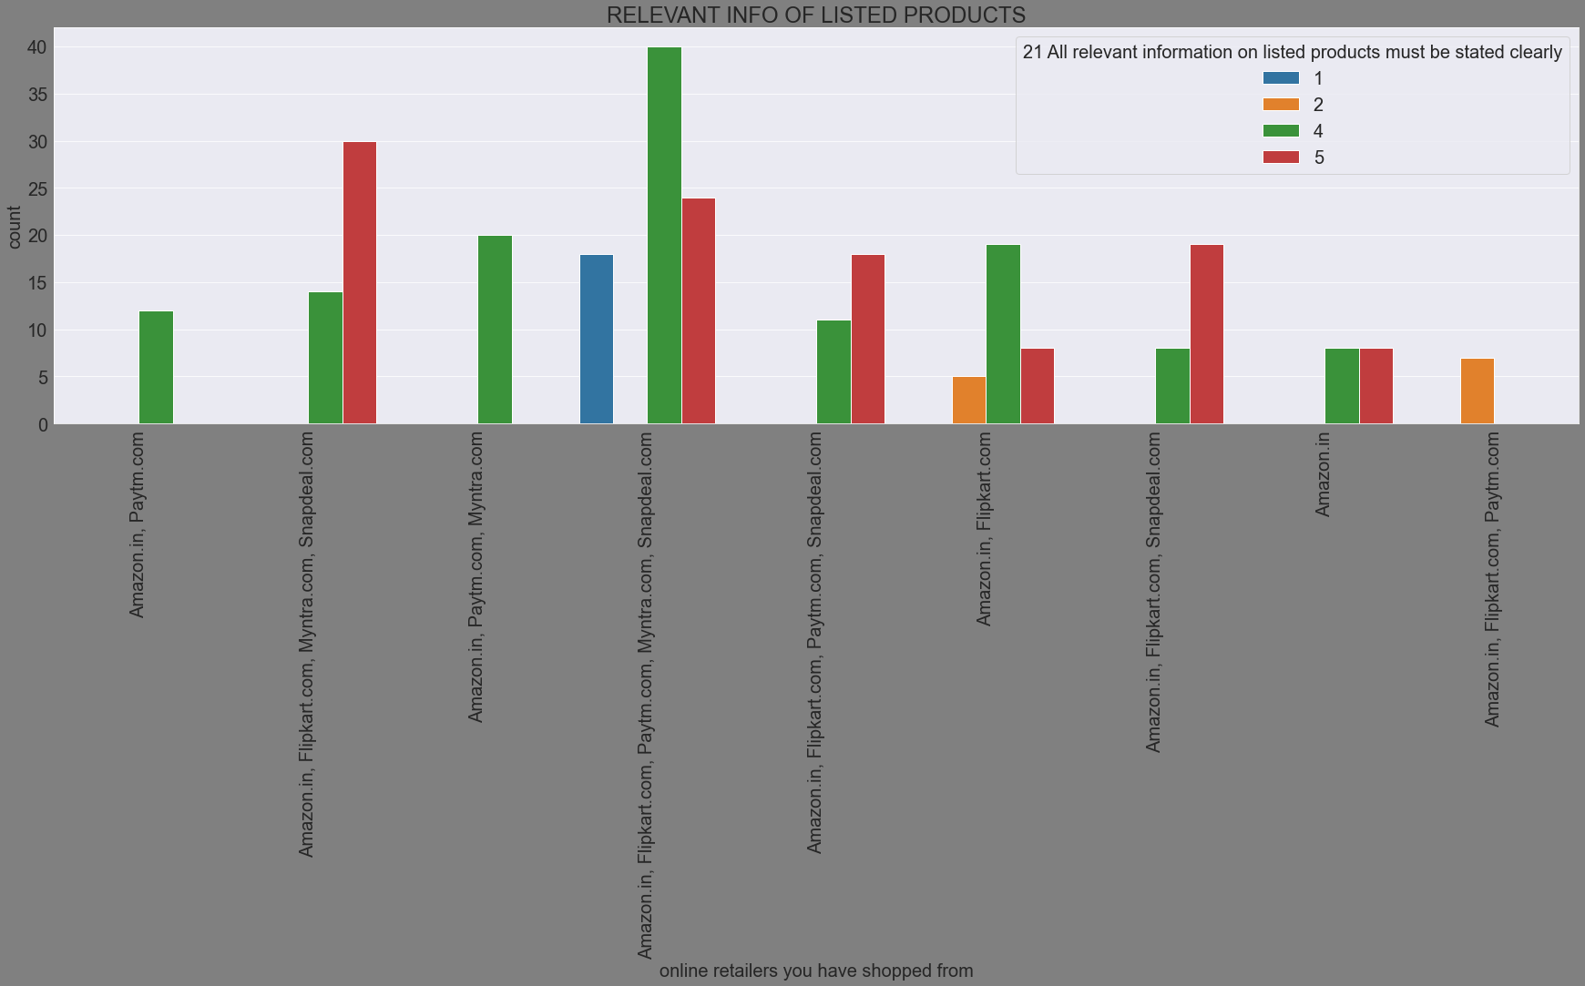

Slide 7
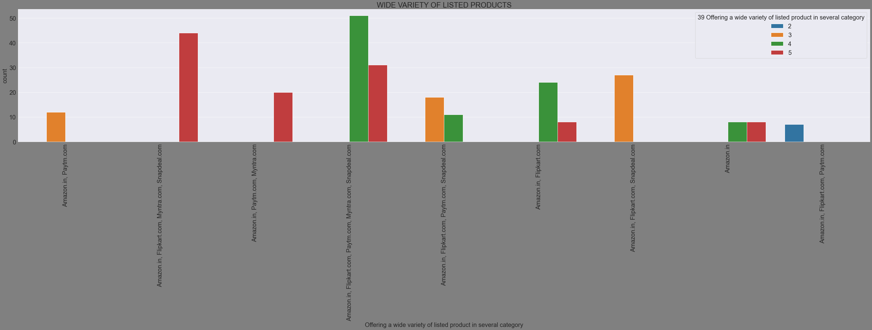

Slide 8
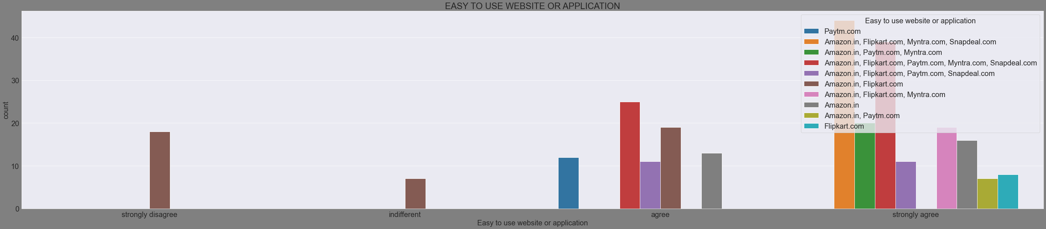

Slide 9
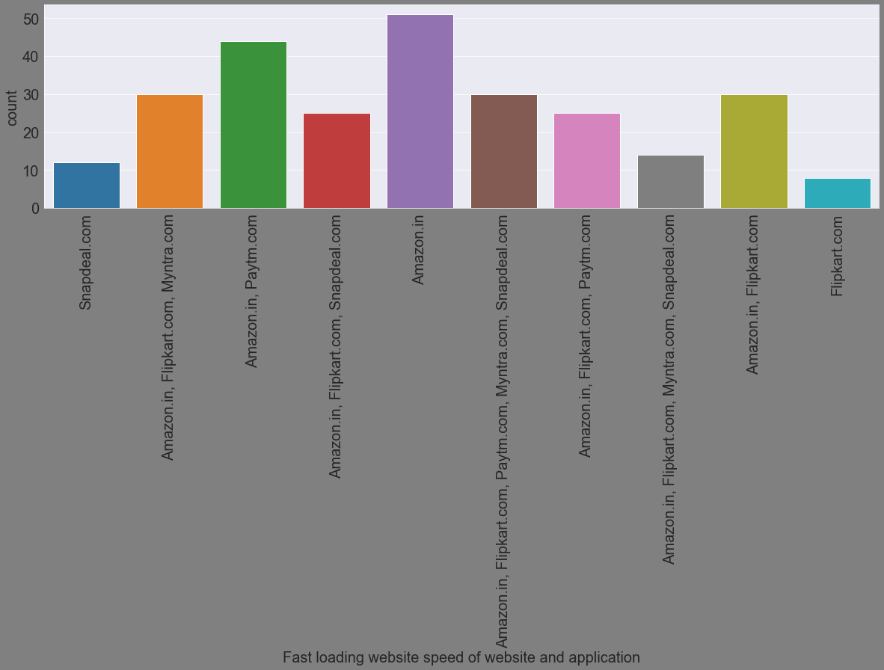

Slide 10
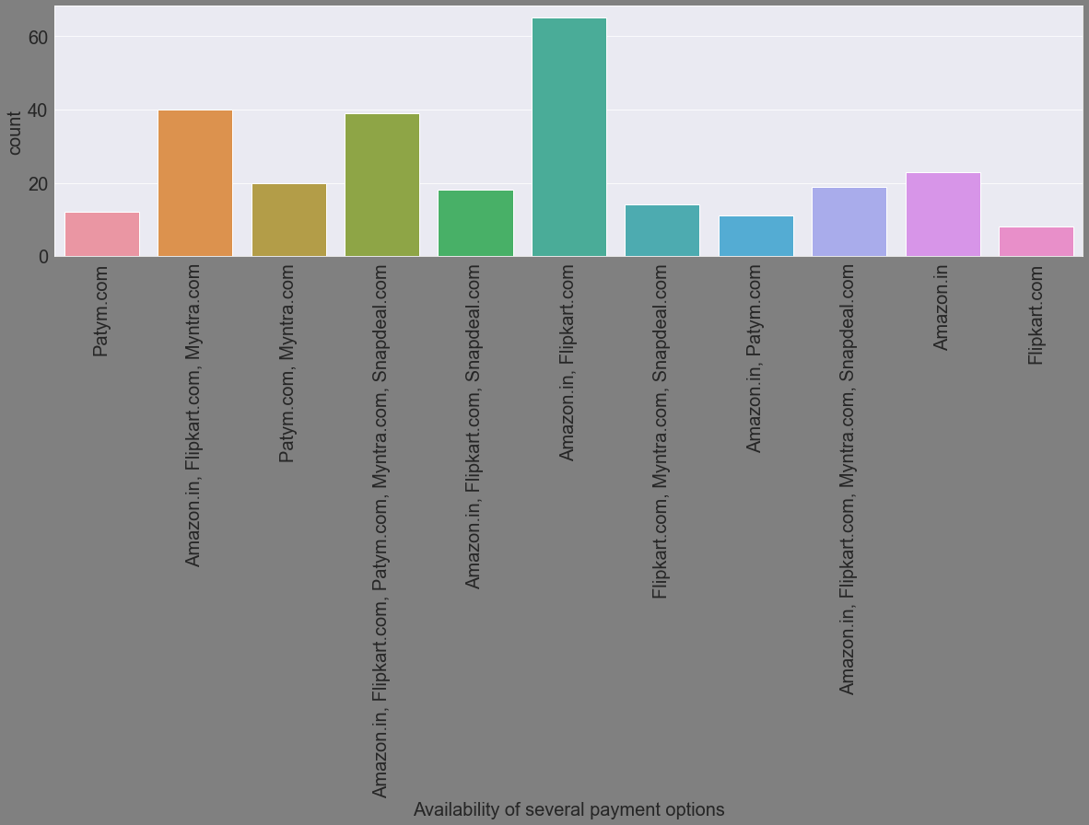

Slide 11
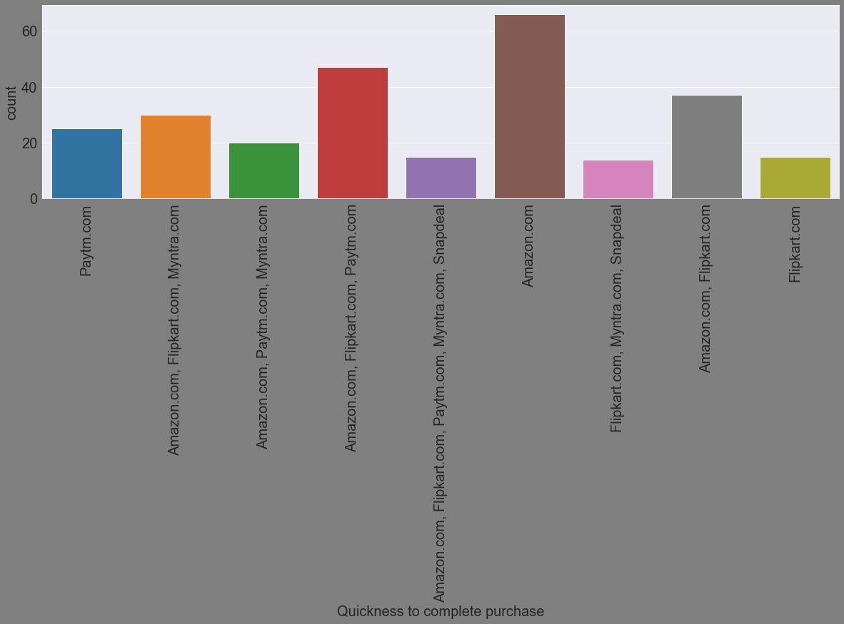

Slide 12
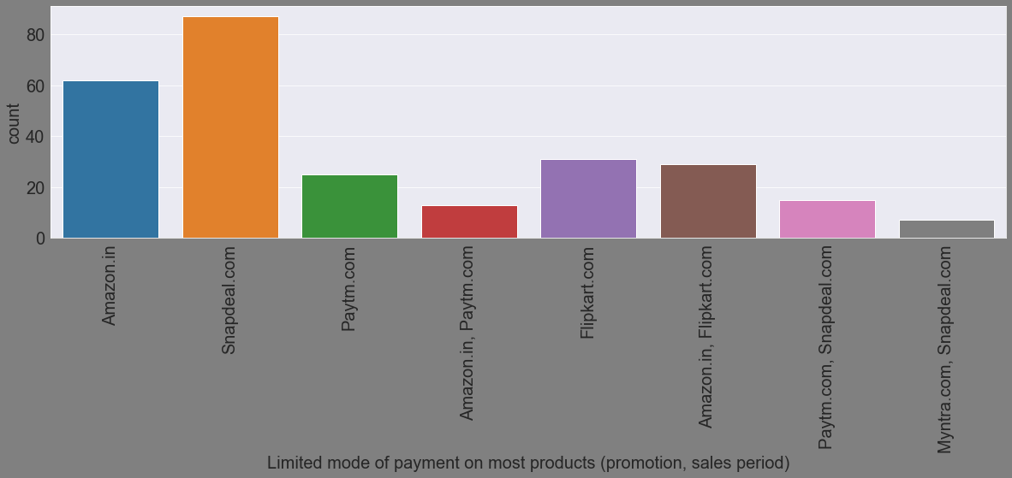

Slide 13
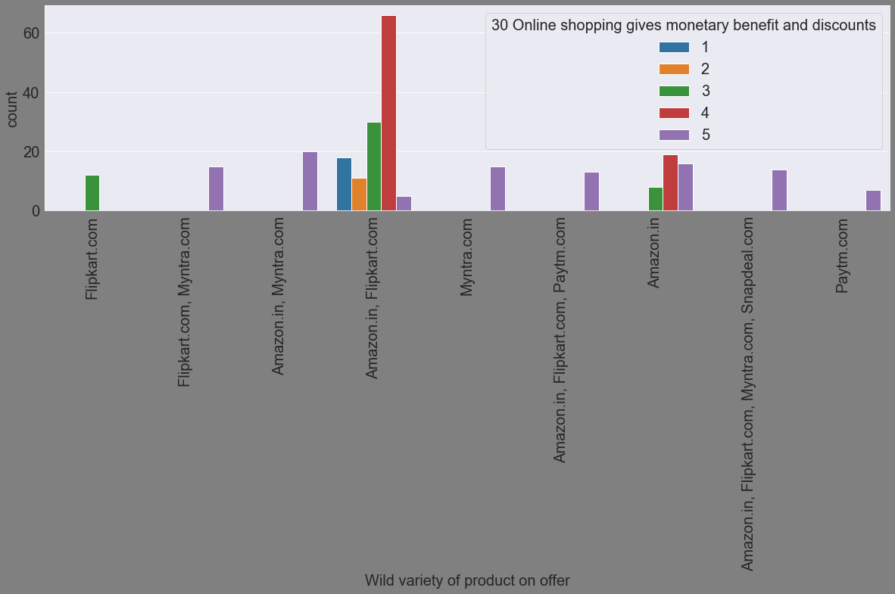

Slide 14
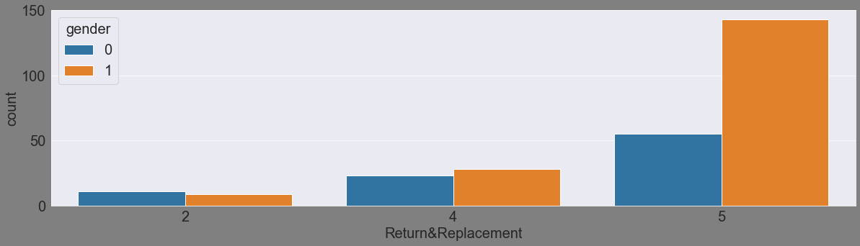
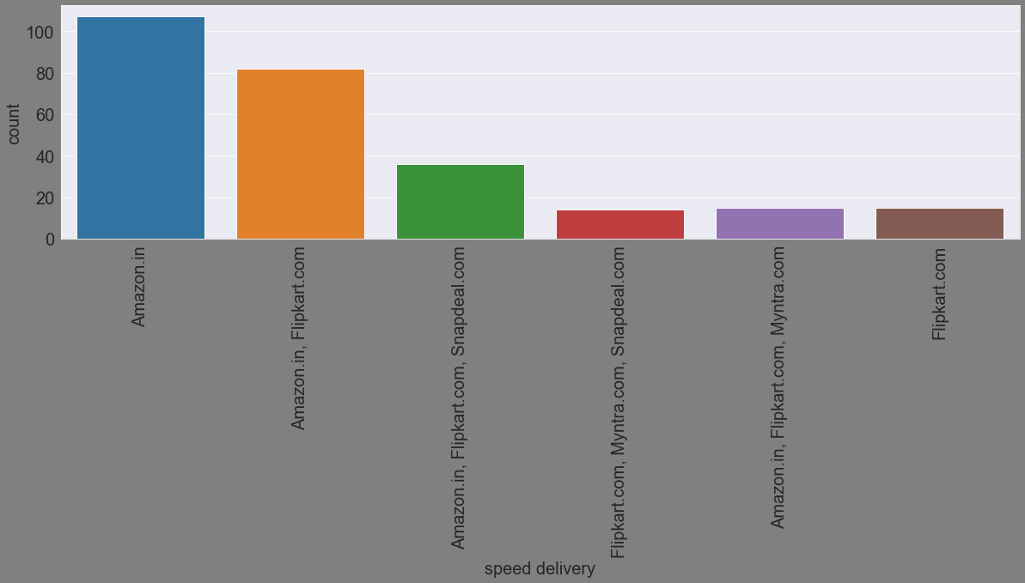

Slide 15

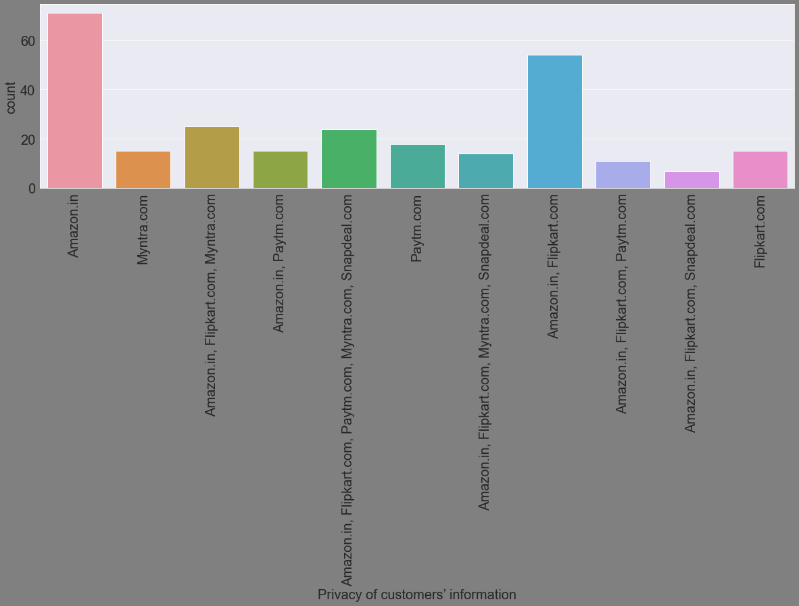

Slide 16
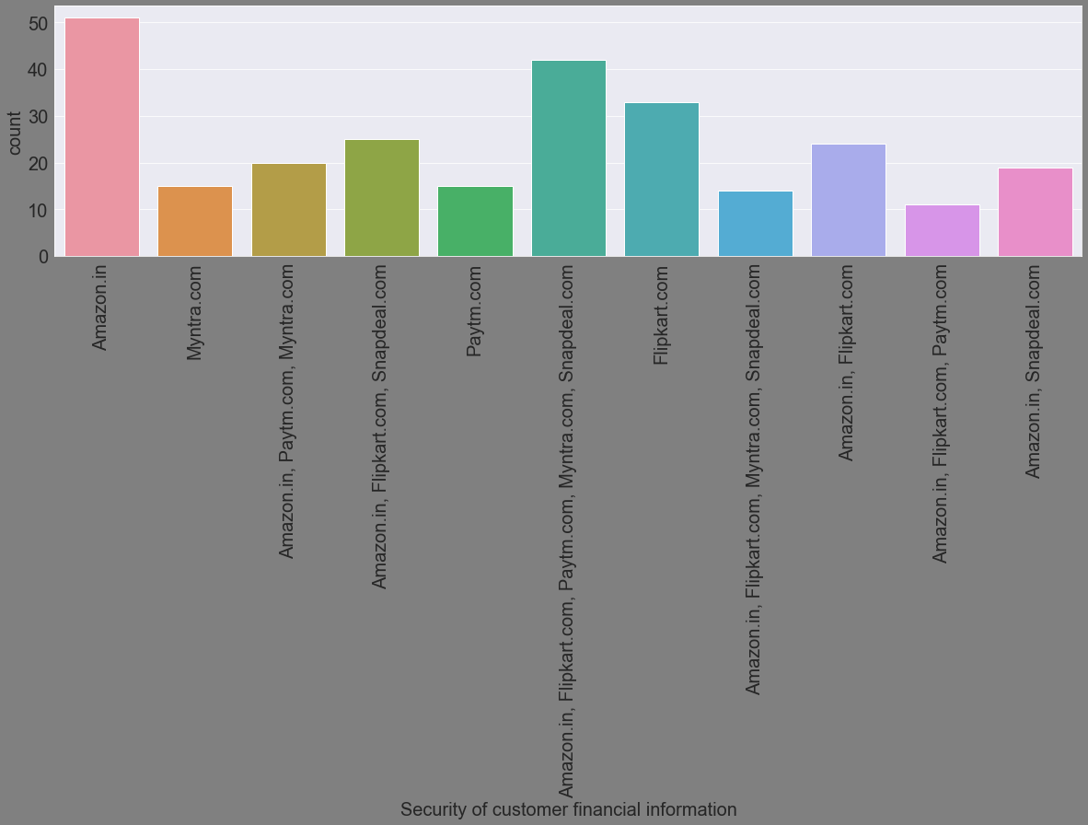

Slide 17


